Slide 1
Effective Presentation
Lecturer: Ngo Huy Bien
Software Engineering Department
Faculty of Information Technology
VNUHCM - University of Science
Ho Chi Minh City, Vietnam
nhbien@fit.hcmus.edu.vn

Slide 2

Objectives
To prepare and make a presentation.

Slide 3

Contents
Presentation Tips
Mind Map
Concept Map
Language & Perception
How to Market Your Idea

Slide 4

References
John W. Budd (2003). Mind Maps as Classroom Exercises.
Joseph D. Novak (2006). The Theory Underlying Concept Maps and How.
Nancy Duarte (2008). Slide:ology.

Slide 5


Why Effective Presentation?
Communication issue.

Slide 6
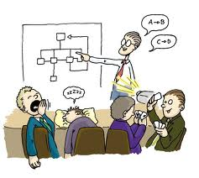

Presentation Tips
The Preparation
The Problem, The Solution
What, How, Why, Who, When
The Eyes, The Voice, The Expression, The Speed, The Smiles
Pictures, Jokes, Natural, Short, Sweet, Self-Confident, Rehearsal

Slide 7
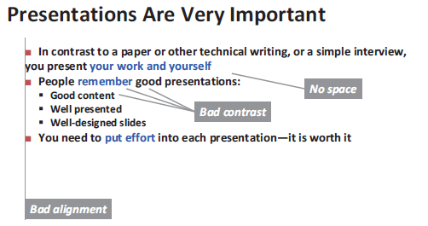
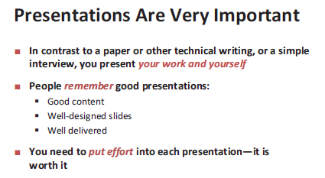
Spaces, Contrast and Alignment [1]

Slide 8
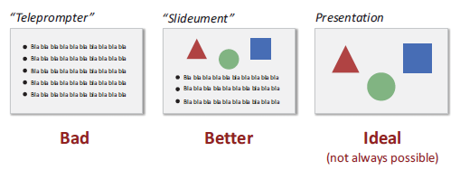
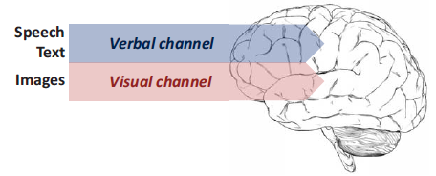
Text Versus Images
You cannot read and listen at the same time.

Slide 9

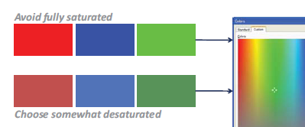
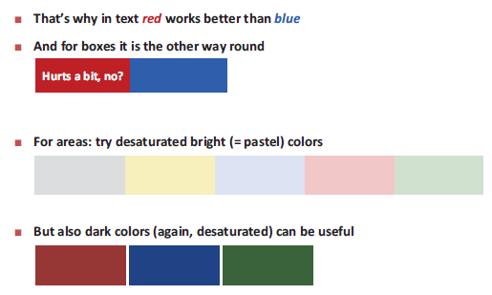
Colors

Slide 10
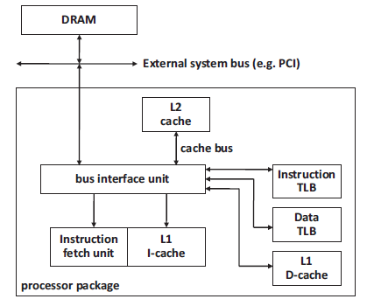
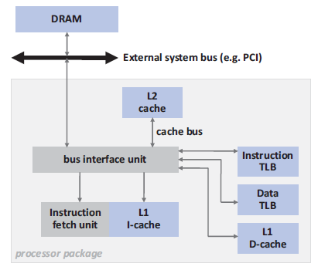
Boxes

Slide 11

Tips for Designing Slide
https://www.garrreynolds.com/preso-tips/design/
Keep it simple
Limit bullet points & text
Limit transitions & builds (animation)
Use high-quality graphics

Slide 12

Mind Map [2]
A mind map is a form of an outline with ideas and pictures radiating out from a central concept.
https://www.mindmanager.com/en/

Slide 13
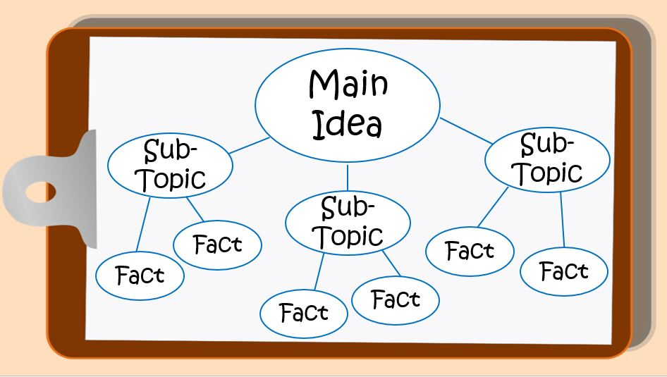
Concept Map [3]
Concept maps are graphical tools for organizing and representing knowledge.
They include concepts, usually enclosed in circles or boxes of some type, and relationships between concepts indicated by a connecting line linking two concepts.
https://cmap.ihmc.us/

Slide 14


Language & Perception
Description of events ↔ Language ↔ Perception
Look, listen, draw, and talk.
Why? – Because they force the engagement of your linguistic motor and your visual apparatus.
Beware of fast talkers.
Why? – It's because that when they talk fast they're jamming your language processor and you can't think.
https://www.youtube.com/watch?v=PimSbFGrwXM

Slide 15
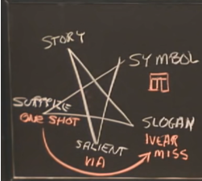
How to Market Your Idea
You can't learn unless you almost know already.
Symbol (Arch)
Slogan (Near Miss)
Surprise (One-shot learning)
Salient (“Stick out”)
Story
https://www.youtube.com/watch?v=sh3EPjhhd40
https://www.youtube.com/watch?v=Unzc731iCUY

Slide 16

Thank You & See You Again

